Slide 1

Using Machine Learning to Detect Credit Card Fraud
By Angelneke Grayson, Brannan Geshwind, Christina Esquivel, Monila Khadka & Nathan Humphreys Lucas
Notes:
christina

Slide 2
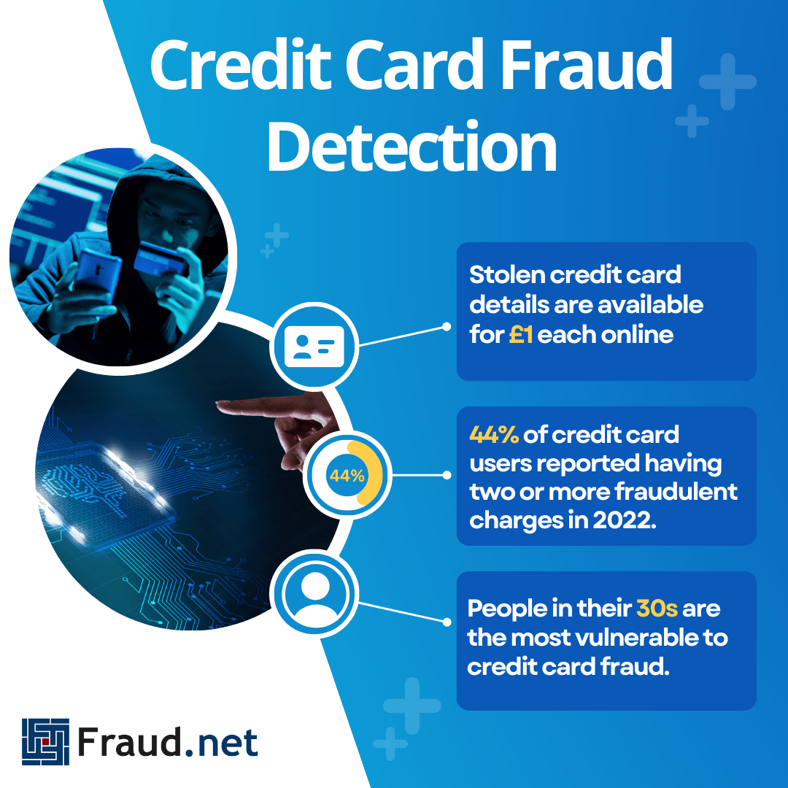
Introduction
Fraud detection plays a pivotal role in safeguarding financial systems and preserving trust among consumers and institutions. By identifying and mitigating fraudulent activities, fraud detection bolsters confidence in financial services, fostering a secure environment for economic interactions. Moreover, its proactive nature not only minimizes financial losses but also curtails the potential ripple effects that fraud can have on individuals, businesses, and the broader economy. Ultimately, robust fraud detection measures serve as a cornerstone in upholding transparency, reliability, and trust within financial operations, vital for sustained economic health and progress.
Notes:
christina

Slide 3


Overview
develop an effective fraud detection system
utilize machine learning techniques
minimize losses and safeguard against fraudulent activities.
Objective
implement machine learning models for identifying fraudulent credit card transactions
dataset obtained from creditcard.csv
analyze transaction patterns, and relationships between variables
establish predictive models for fraud detection.
Notes:
christina

Slide 4
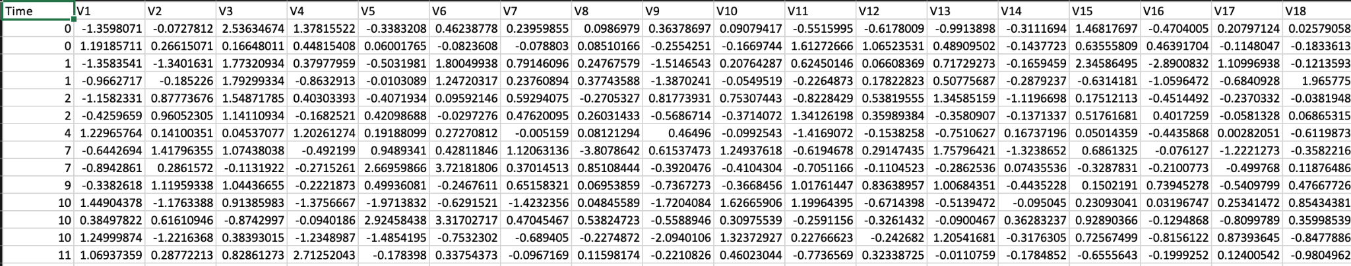
Looking at our Dataset
The CSV dataset contains transactions made by credit cards in September 2013 by European cardholders which occurred in two days.
Our dataset contains anonymized information due to confidentiality concerns.
It includes various transaction attributes such as transaction amounts, timestamps, and other relevant features necessary for training and evaluating the models.
V1 through V28 are the principal components obtained through PCA transformation. “Amount” is the transaction amount, “Time” has seconds elapsed between each transaction and the first transaction in the dataset. “Class” has Fraud (1) and Non-Fraud(0) variables.
Notes:
brannan

Slide 5
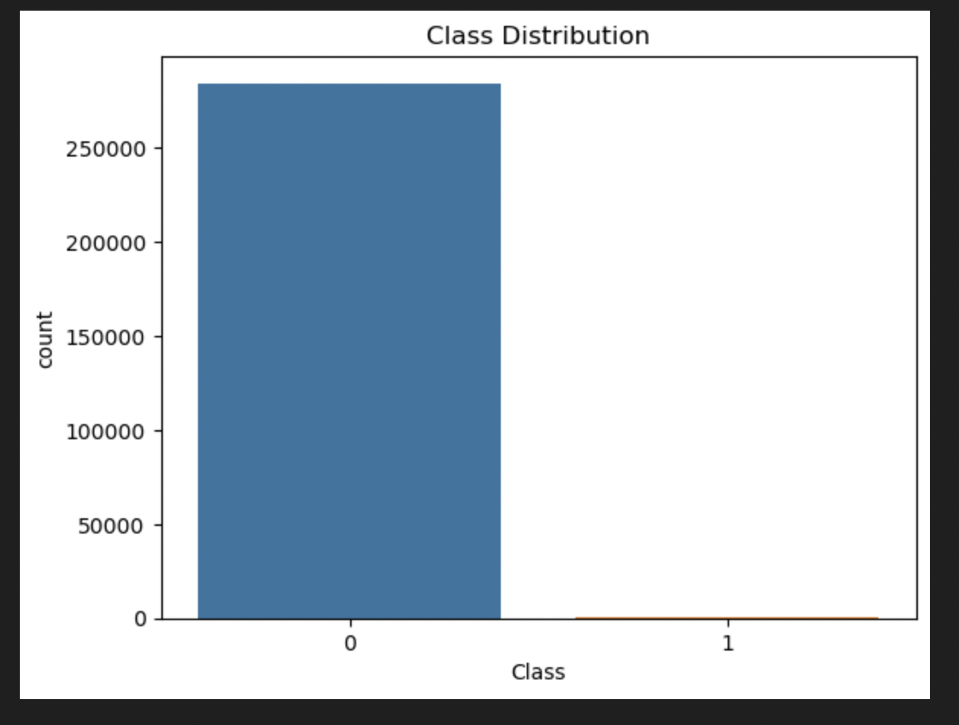
Data Exploration
0 = Non Fraud (284315 instances). 99.8% of the total.
1= Fraud (492 instances) . Only 0.17% of the total.
Conclusion: Highly imbalanced dataset. This can result in bias toward the majority class, resulting in poor predictions for minority class (for our case the Fraud).
Notes:
brannan

Slide 6
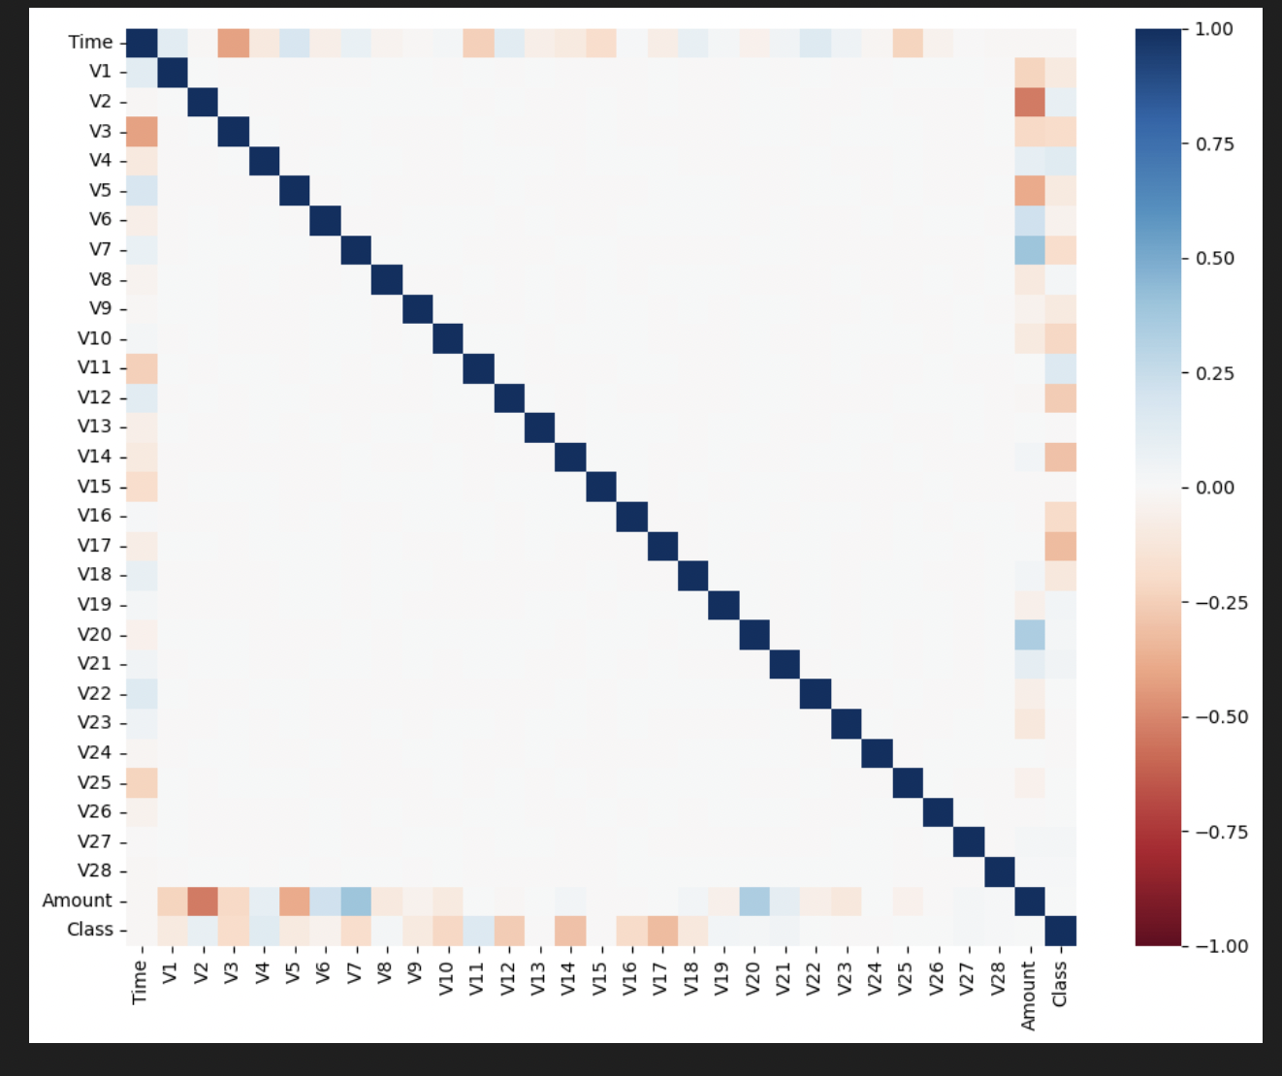
Data Exploration: Heatmap and Correlation Matrix Plot of the Original Datasets
No much correlation.
Notes:
monilla

Slide 7
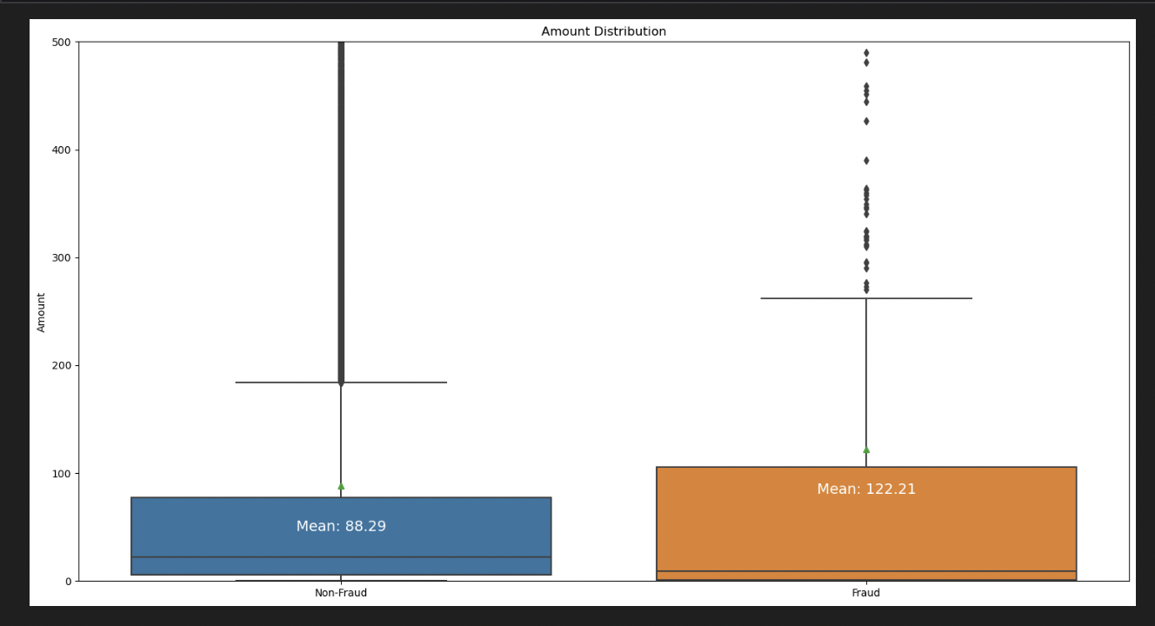
Data exploration: Boxplot of Amount Distribution Between the Classes
The Mean for Fraud was much higher than the Non-Fraud.
A lot of outliers in each cases.
Notes:
monilla

Slide 8
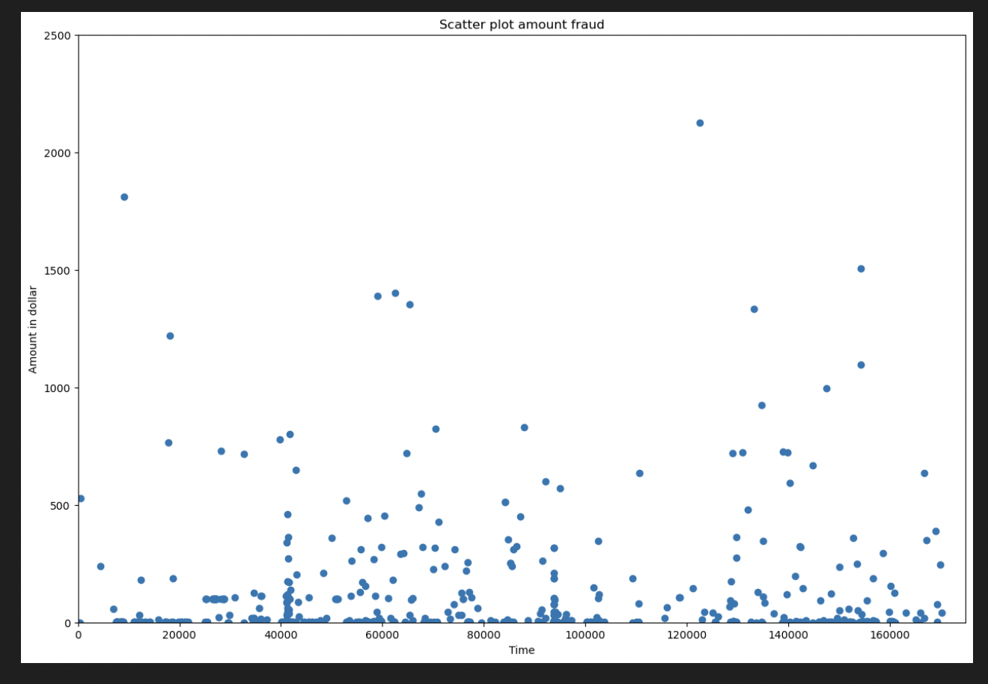
Scatter Plot of Amount vs Time for Fraud
Most of the fraud transactions were for amount under 500.
Notes:
monilla

Slide 9
Methodology
Data preprocessing:
Import CSV file and create MongoDB, then use Python’s pymongo library to interact. Use Panda to create a dataframe.
Looking for missing/ null value in our dataset.
Scaling our “Time” and “Amount” using RobustScaler.
Separating our original data into training and test datasets using sklearn.
Application of the following techniques to handle imbalanced data of our train datasets using imblearn:
Random Undersampling Rebalancing Method
Random Oversampling Rebalancing Method
Combination of both using SMOTEENN
Notes:
angel

Slide 10
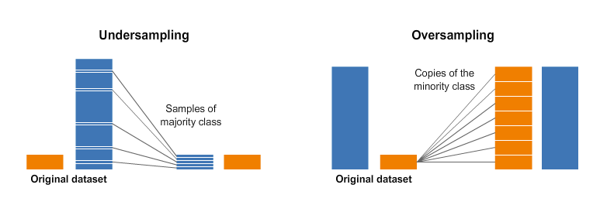
Under vs Oversampling
https://www.kaggle.com/code/rafjaa/resampling-strategies-for-imbalanced-datasets
Notes:
angel

Slide 11
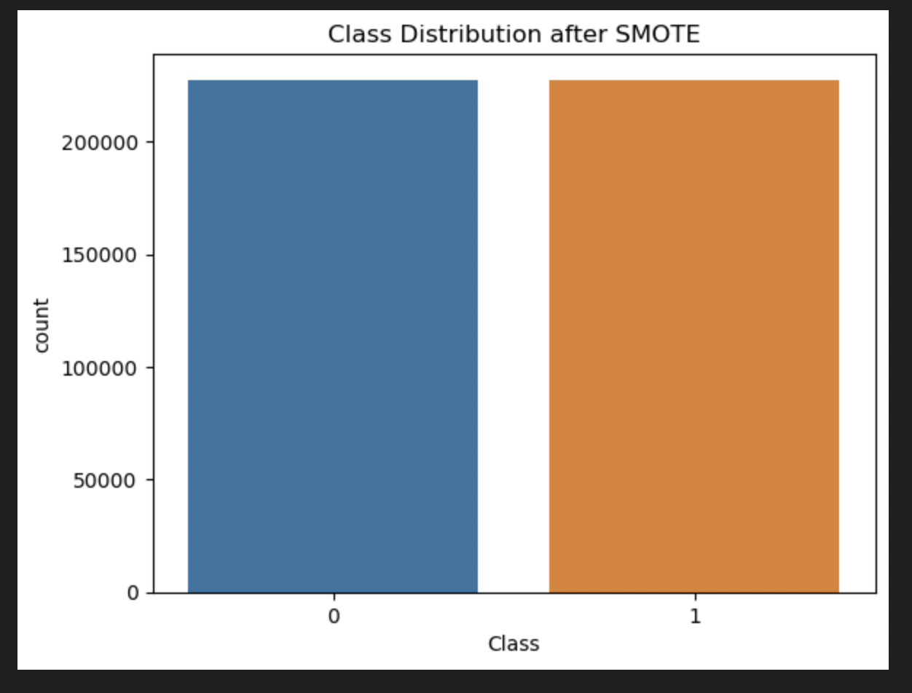
An Example of Balancing Imbalanced Data: Original vs SMOTE (oversampling)
Notes:
angel

Slide 12
Model Training and Selection
Application of 3 machine learning models in three rebalancing techniques:
LogisticRegression
DecisionTreeClassifier
RandomForestClassifier
Creating a classification matrix showing precision, recall, f1-score and accuracy.
Creating a confusion matrix
Notes:
nathan

Slide 13
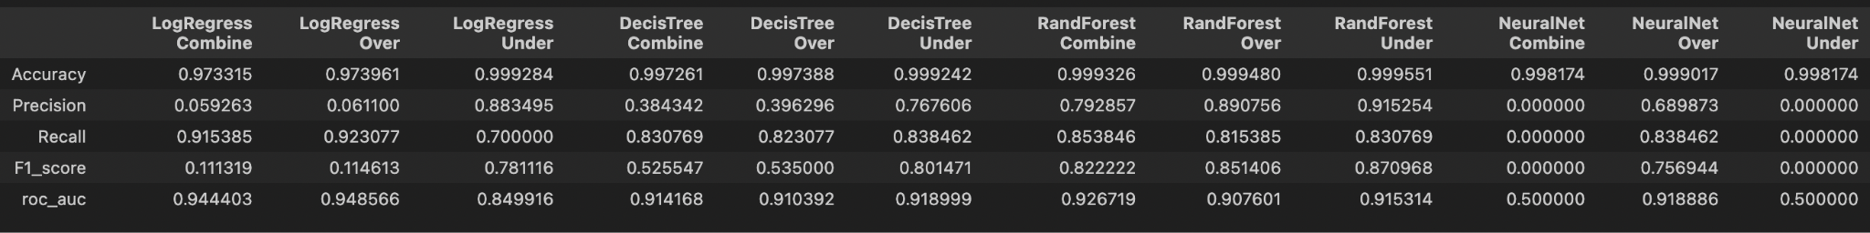
Analyzing Results
Notes:
nathan

Slide 14
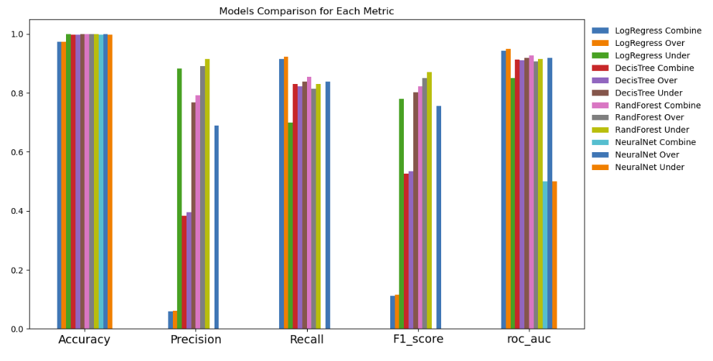
Analyzing Results contd…
Notes:
nathan

Slide 15
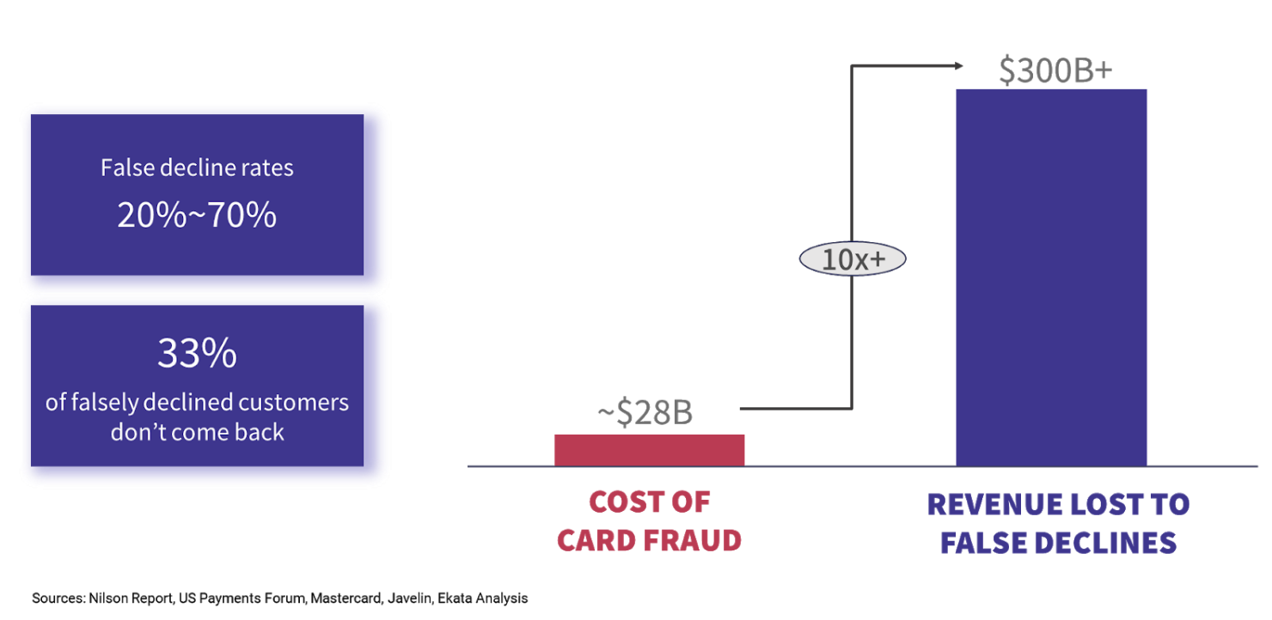
What metrics to look for ?
Our recommendation:
Consider the trade-off between false positives and false negatives based on the priorities of our application.
If going for more conservative and minimizing false positives (false declines), focus on precision.
If capturing as many actual fraud cases as possible is crucial, focus on recall.
For credit card fraud detection, we wanted to minimize both false positives and false negatives. In such case, F1-score was the metric to consider for model selection. In our case Random Forest model, using over (0.85) or undersampling (0.87) rebalancing techniques had the best F1-score .
Notes:
brannan

Slide 16
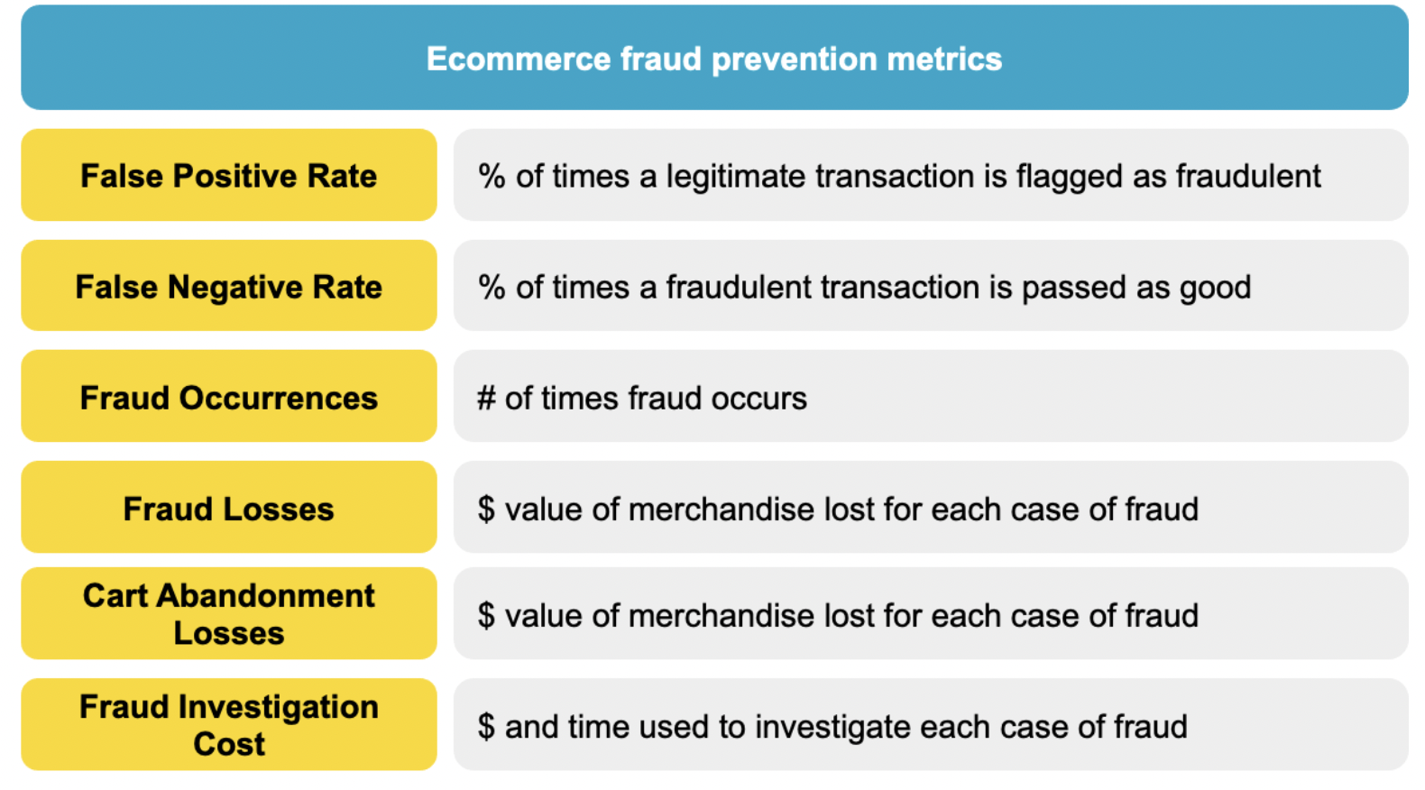
Challenges Faced
When we first started we intended to use one balancing technique to our dataset then apply three machine learning models.
After a lot of published literature review, our team was divided on which techniques to balance. Hence, we ended up using three popular balancing techniques to see the impact it has on our models.
Best metric selection for our imbalanced datasets.
Notes:
brannan

Slide 17
Conclusion
In conclusion, the significance of fraud detection in financial systems cannot be overstated, as it serves as a critical safeguard for both consumers and institutions, fostering trust and ensuring the integrity of economic interactions. By proactively identifying and mitigating fraudulent activities, fraud detection contributes not only to minimizing financial losses but also to preventing potential cascading effects on individuals, businesses, and the broader economy. This project, focused on developing an effective fraud detection system using machine learning techniques, aims to address the challenges posed by an imbalanced dataset containing a vast majority of non-fraud instances. Through the application of three machine learning models and three rebalancing techniques, the project aims to strike a balance between minimizing false positives and capturing as many actual fraud cases as possible, ultimately prioritizing the F1-score metric for model selection.
Through thorough data exploration, the team identified key characteristics, including transaction amounts and time intervals, and observed a higher mean for fraud transactions. The project's approach involved the application of Logistic Regression, Decision Tree, and Random Forest models, considering various rebalancing techniques. The recommendation emphasizes the importance of the F1-score metric in balancing the trade-off between false positives and false negatives. By employing over and undersampling techniques, the Random Forest model demonstrated the best F1-score, highlighting the nuanced considerations needed for effective fraud detection in imbalanced datasets.
Notes:
Angel

Slide 18

QUESTIONS
Notes:
nathan,Angel

Slide 19

Work Cited
Measuring Performance: AUPRC
Credit Card Fraud Detection - Machine Learning Projects
Machine Learning for Fraud Detection - Fraud Detection Handbook
A machine learning based credit card fraud detection using the GA algorithm for feature selection

